Slide 1
Sports Analytics Competition- SME, IITJ
Team Name: Prometheus
Members:
1) Samanvay Lakhotia (Team Leader)
2) Nishant Jain
3) Akshat Srivastava

Slide 2
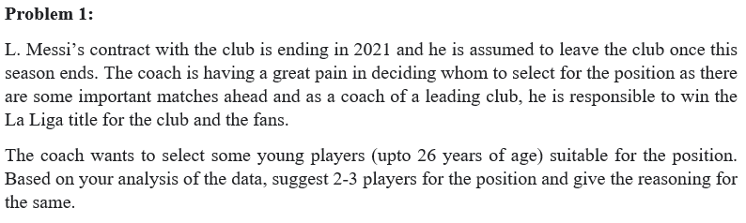
Problem Statement 1
Important consideration points:
Lionel Messi is a regular and a very important player on the field for FC Barcelona. We need someone to replace him in the team immediately, someone who can take to the pitch immediately.
FC Barcelona being a pretty big club, wouldn’t mind paying for the transfer clause of excellent players with capabilities like Messi. Hence, their current contract validity won’t really matter.
Young players required (Age ≤ 26)

Slide 3
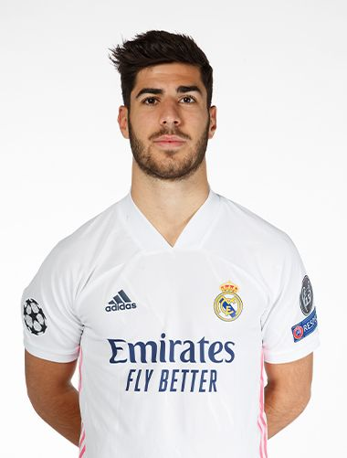


Our recommendations:
Paulo Dybala 2. Marco Asensio 3. James Rodríguez

Slide 4
Methodology of generation of our
recommendations:
Messi is a Right Wing player by position, but plays mostly in attacking zones, scoring goals. For his replacement, we’d desire the same characteristics: Attacking and Midfield presence.
We generated a new metric for “Difference from Messi” * based on the ratings for RF, RW, RS, RAM, and the various ratings for a player’s skill (only related to Attacking and midfielding).
We found that these 3 players had the least difference from Messi in comparison to all the other players. Hence, we select these players for our final recommendation from the entire dataset.
* : For more details, you may see our .ipynb file.

Slide 5
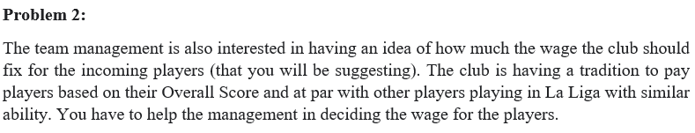
Problem Statement 2
Important Points to note:
Our analysis is only for Wages of La Liga players.
We found out that Wage is biquadratically dependant on Overall Score, and linearly dependant on Value of a player, their release clause and their age (years of experience would be a better term).
Also, Wage of a player increases with their International Reputation, which is as expected, since clubs would be willing to pay higher amounts for better players of International repute.

Slide 6
Methodology for recommendation of Wages:
Predicted Wages for our players:
We make 2 ML models:
Polynomial of degree 4: B/w Wage and Overall Score.
Multiple Linear Regression: B/w Wage and Value, Release Clause, Age.
Next, we ensemble the learnings of these 2 models, to get a final model with better predictive power (without overfitting), by taking the best of both models!
The predicted values of Wages for the selected players are:
Paulo Dybala : €419K
Marco Asensio : €208K
James Rodríguez : €236K

Slide 7
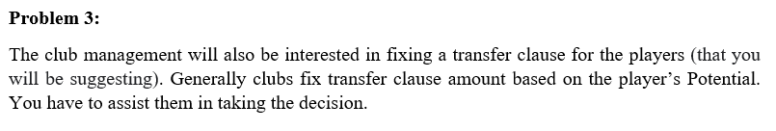
Problem Statement 3
Important Points to note:
We found that Transfer Clause is biquadratically dependant on the Potential of the player. As the problem statement also requires using the Potential, we pay special emphasis on it here.
Also, Transfer Clause is linearly dependant on Value of a player, and their Wage.
Here, we’ll use the complete dataset, not limited to any particular League, as we did in case of Problem Statement 2.

Slide 8
Methodology for recommendation of Transfer Clause:
Predicted Transfer Clauses for our players:
We again make 2 ML models:
Polynomial of degree 4: B/w Transfer Clause and Potential.
Multiple Linear Regression: B/w Transfer Clause and Value, Wage of a player.
Next, we ensemble the learnings of these 2 models, to get a final model with better predictive power (without overfitting), by taking the best of both models!
The predicted values of Transfer Clauses for the selected players are:
Paulo Dybala : €161M
Marco Asensio : €112M
James Rodríguez : €107M

Slide 9
Thank you!

